Slide 1
Compiler Construction
Lecture 4

Slide 2
Topics Covered in Lecture 3

Slide 3
Role of Lexical Analyzer
Errors generated by Lexical Analyzer
Tokens
Lexemes
Patterns

Slide 4
Lexical Analyzer
Part 2

Slide 5
Specification of Tokens
Lexemes are simple sequence of characters
Tokens are sets of lexemes....
So: Tokens form a REGULAR LANGUAGE
Regular Expressions- important notations for specifying patterns
Use REGULAR EXPRESSION to precisely describe what strings each type of token can recognize
(Reference: Page 94 onwards)

Slide 6
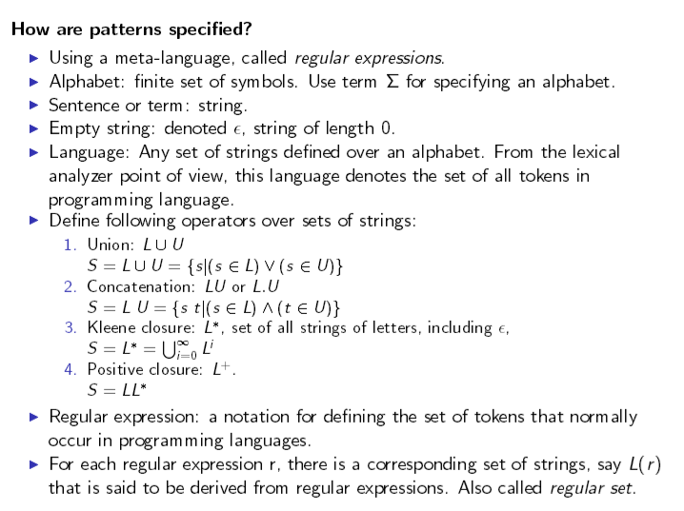
Regular Expressions

Slide 7
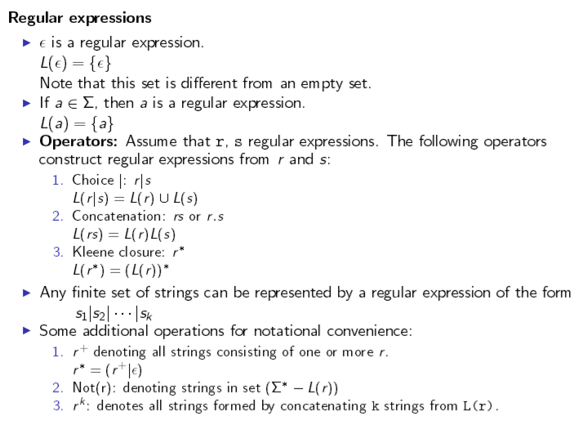
Regular Expressions

Slide 8
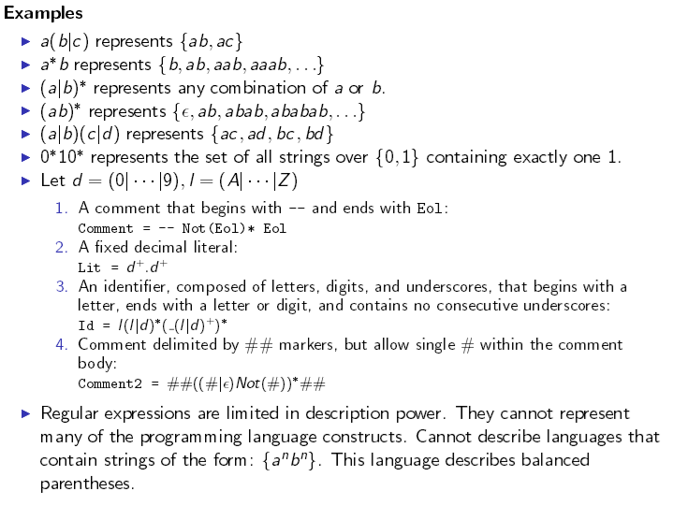
Examples

Slide 9
Learn by Example:
Token to be specified = Identifier of C
  letter → A | B | C | … | Z | a | b | … | z
  digit → 0 | 1 | 2 | … | 9
  identifier → letter ( letter | digit )*

Slide 10
Another Example:
Let the grammar fragment be:
if expr then stmt
expr → term relop term
What are the patterns (Regular Expressions) for the following tokens?
Terminals Set of strings
If → if
then → then
else → else
relop → < | <= | > | >= | = | <>
(Reference: Exp 3.6, Page 98)

Slide 11
Learn by Doing
Pattern for All Strings that start with “tab” or end with “bat” ?
Answer
tab {A,…,Z,a,...,z}* | {A,…,Z,a,....,z}*bat

Slide 12
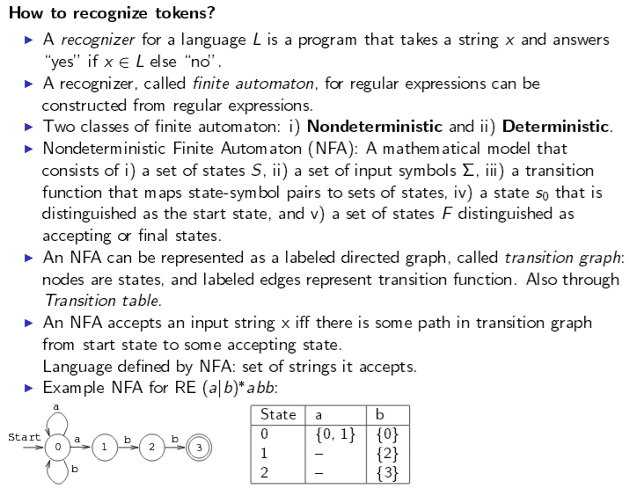
Token Recognition

Slide 13
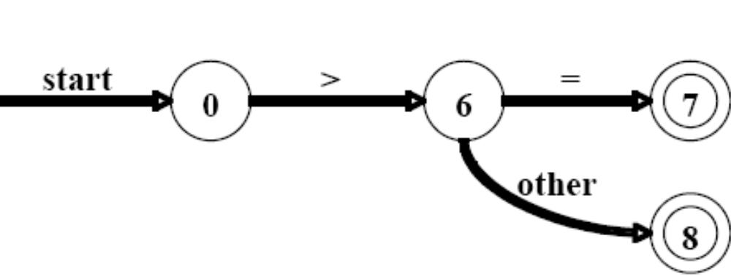
Token Recognition
Transition diagram
Depicts sequence of actions a lexical analyzer take, when called by the parser to get next token
Used to keep track of info about characters during scanning of input
Example: Token to be specified >= and >
Return (relop, GE)
*
Return (relop, GT)

Slide 14
Learn by Example
Relational Operators in Java
  < <=
  > >=
  = <>
Specification of token relop
relop → < | <= | > | >= | = | <>
Recognition of token relop

Slide 15
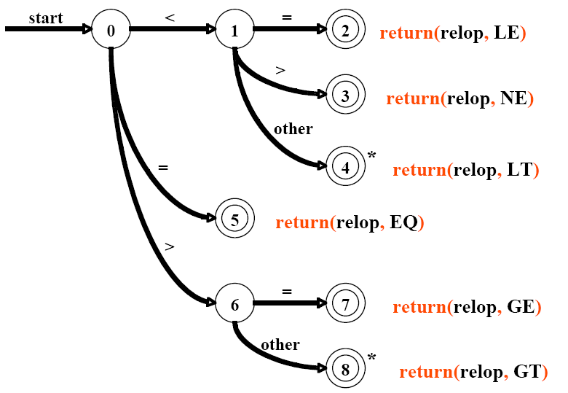

Slide 16
Learn by Doing
Identifiers in Java
  position
  Sal123
  ab
  x
Specification of token identifier
  identifier → letter ( letter | digit )*
Recognition of token identifier ?

Slide 17
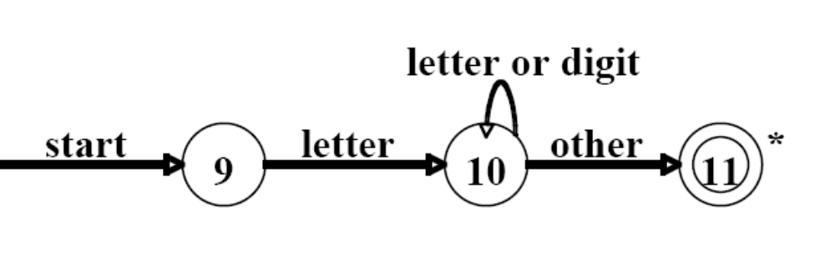
Learn by Doing

Slide 18
Terminologies : Automata & Language Theory
Finite State Automata (FSA)
  A recognizer that takes an input string and determines whether it’s a valid string of the language.
Non-Deterministic FSA (NFA)
  Has several alternative actions for the same input symbol
Deterministic FSA (DFA)
  Has 1 action for any given input symbol

Slide 19
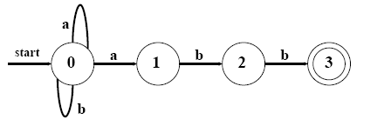
Representing NFA
1) Transition Graph:
Number states (circles), arcs, final states, …
What language is defined?
(a|b)*abb

Slide 20
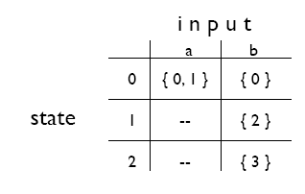
Representing NFA
2) Transition Tables:
More suitable for representation within a
computer

Slide 21
Learn by Example
Given the regular expression :
  (a (b*c)) | (a (b | c+)?)
Find a transition diagram NFA that recognizes it

Slide 22
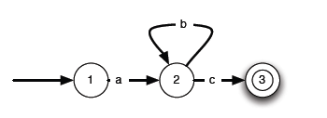
Learn by Example – NFA construction
Step 1: (a (b*c)) | (a (b | c+)?)
(a (b*c))

Slide 23
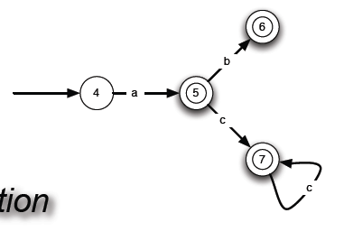
Learn by Example – NFA construction
Step 2: (a (b*c)) | (a (b | c+)?)
(a (b | c+)?)

Slide 24
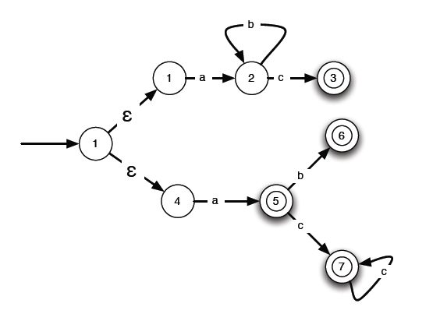
Learn by Example – NFA construction
  Step 3:(a (b*c)) | (a (b | c+)?)
0

Slide 25
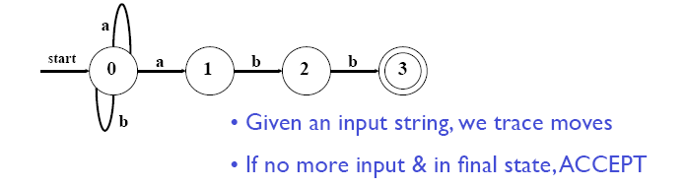
Working of NFA
Learn by Example:
Input: ababb
move(0, a) = 1
move(1, b) = 2
move(2, a) = ? (undefined)
REJECT !
OR
move(0, a) = 0
move(0, b) = 0
move(0, a) = 1
move(1, b) = 2
move(2, b) = 3
ACCEPT !

Slide 26
The NFA Problem
Two problems
– Valid input may not be accepted
– Non-deterministic behavior from run to run…
Solution ?

Slide 27
The DFA Saves The Day
A DFA is an NFA with a few restrictions
No epsilon transitions
For every state s, there is only one transition (s,x) from s for any symbol x in Σ

Slide 28
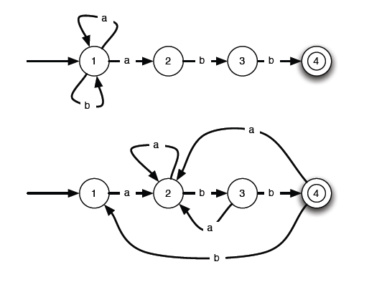
NFA-DFA comparison (???)

Slide 29
How does this all fit together ?
Reg. Expr. → NFA construction
NFA → DFA conversion
DFA simulation for lexical analyzer
Point to Remember
  Both NFA and DFA can be used to recognize tokens, but DFA are faster and more optimizable than NFA

Slide 30
Lets Revise!

Slide 31
Tokens can be specified by using regular expressions
Tokens can be recognized through transition diagrams generated by regular expressions
A transition diagram may be NFA or DFA but DFA is preferable because of its speed and optimization

Slide 32
Home Work
Write down the specification of Regular Definition for:
“Unsigned numbers in C are strings such as 6250, 36.25, 6.235E4 or 1.25E-3.
Use the shorthand notation

Slide 33
Home Work
Try to study and understand Input Buffering Section 3.2 Page 88 of your book
Specify a pattern for white spaces using regular expressions and make transition diagram to recognize it.
Specify a pattern for all Strings in which {1,2,3} exist in ascending order and make transition diagram to recognize it.

